Slide 1
Where’s Sally?
Sally is running up and down in front of a motion sensor.
The motion sensor is used to draw a graph of her movement.
8
6
4
Distance from start / m
2
0
0
4
8
12
16
20
Time / s

Slide 2
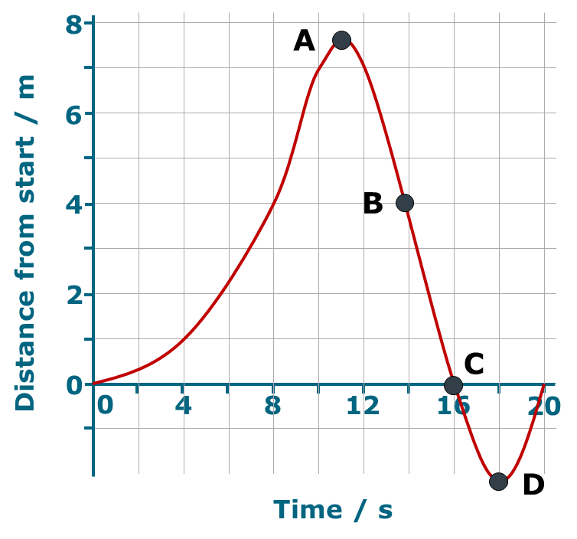
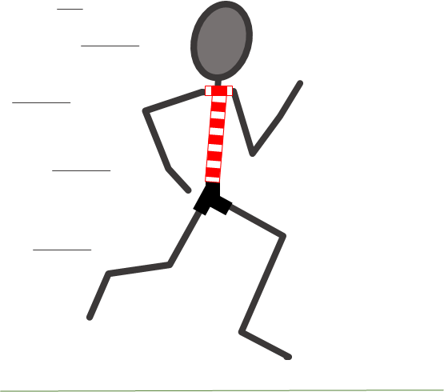
Where’s Sally?
The graph represents Sally’s motion.
The statements describe what the graph shows about how Sally is moving.
What do you think about each one?
I am sure this is right
I think this is right
I think this is wrong
I am sure this is wrong
At A Sally is running her fastest
At B Sally is running towards the start
At C Sally has stopped
At D Sally is behind the starting line

